Slide 1
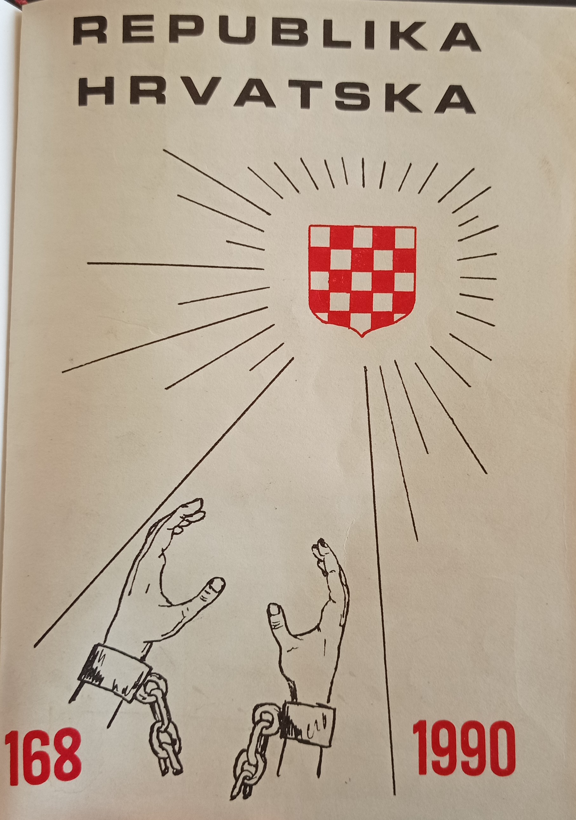
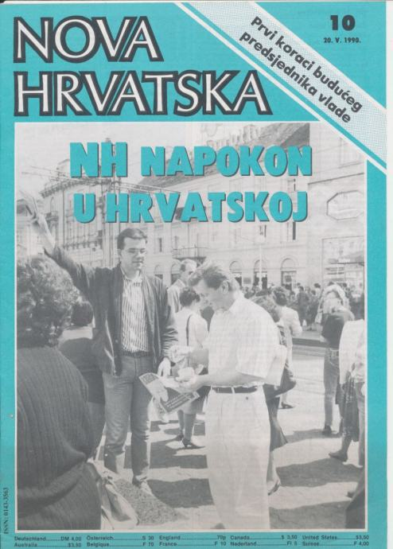
Criticism of the communist legacy in the Republic of Croatia on the pages of the magazines Republika Hrvatska and Nova Hrvatska

Slide 2
introduction
The path of the Republic of Croatia from a totalitarian to a democratic system was immeasurably more difficult due to the struggle for national independence
The state of war and the existence of the communist government for almost half a century – fertile ground for the survival of communist elements
The remnants of communism keep Croatia at the bottom of the EU and partly cause mass emigration

Slide 3
Struggle for the creation and defense of the state needed to be parallel to building truly democratic system
Proponents of that idea were Croatian émigrés as well
Examples: Croatian Republican Party and the editor-in-chief of the magazine Nova Hrvatska Jakša Kušan
Stereotype - all émigrés are right-wing extremists and philo-fascists – result of the demonization by the Yugoslav communist regime
People with very different ideological and political orientations
Common goals: creation of an independent and democratic Croatian state and the radical decommunization of the Croatian state and society

Slide 4
Croatian Republican Party
"At a Decisive Moment", Ivo Korsky, 1989
Besides the danger of the growing Greater Serb threat Korsky was warning about the strength of the ruling communist class
Communism shaped many’s worldview
Intellectuals from democratic and Catholic circles "unconsciously accept communist settings and therefore propose hybrid, semi-Marxist solutions and are surprised that new measures coming from the system of free market economy or free, parliamentary democracy do not bring the desired results as in the countries where they are successfully applied."
"Upgraded ideas cannot succeed."
Building democracy on socialist foundations cannot be successful

Slide 5
Partial and superficial democratization actually blocks the way to building a truly free society
Chaos caused by the partial reforms – nostalgia for the period of "order" ("when Tito was alive") – "former" communists taking advantage of this situation
"That is why libertarian reforms introduced superficially and unsystematically or inconsistently are a great obstacle to the realization of a libertarian political and economic system. Indeed, people believe that they are already experiencing a libertarian system and are disappointed by the disorder and difficulties that have arisen, and thus by a libertarian system that they never actually enjoyed."

Slide 6
The task of Croatian and libertarian-oriented intellectuals - spread awareness that Croatia needs radical reforms; freedom cannot be achieved either within the framework of socialism or in a democratic system where the Marxist worldview prevails among the population
Even if a libertarian system is introduced, it will face great difficulties "because people are not ready for freedom after dictatorship, but mentally and emotionally only for another or different dictatorship."
Libertarian society – communists also must be allowed to freely express their political views
The basic idea of the Croatian Republican Party – integral freedom
The struggle for an independent Croatian state + the creation of such a political and social system in which every individual will be free

Slide 7
Nova Hrvatska
Nova Hrvatska’s position: lustration from communism but not revanchism
Kušan warned of the danger that members of the former communist regime would retain power in their hands – fleeing into the ranks of the party that had won the elections - the Croatian Democratic Union
The summer of 1990: „The authority of the government is damaged not only by the Serbian insurgents, but also by all those who abuse the weaknesses and volatility of the new system for their personal interests, be they old crooks in the social enterprises or new careerists in the political structures."

Slide 8
Kušan failed to bring Nova Hrvatska to Zagreb, quickly withdrew from public life in disappointment
The last issue, late 1990, "The Goals Remain the Same"
„The greatest danger for Croatia in the long run comes not from Knin or Belgrade, but from the same contagious habits that destroyed earlier societies."
Calling for "more determined action against careerism in political positions, incompetence, corruption, nepotism and provincialism."

Slide 9
Conclusion – missed chance
Croatian emigrants had the experience to participate in democratic political life – this valuable potential was not used to build a real democracy in Croatia
The diaspora provided enormous support in the establishment and defense of the Republic of Croatia, but had virtually no influence on the government of Croatia and the shaping of the country's political and economic system
The "new class", as Milovan Djilas called the ruling class in the communist system, largely retained its positions in an independent and democratic Croatia

